Slide 1
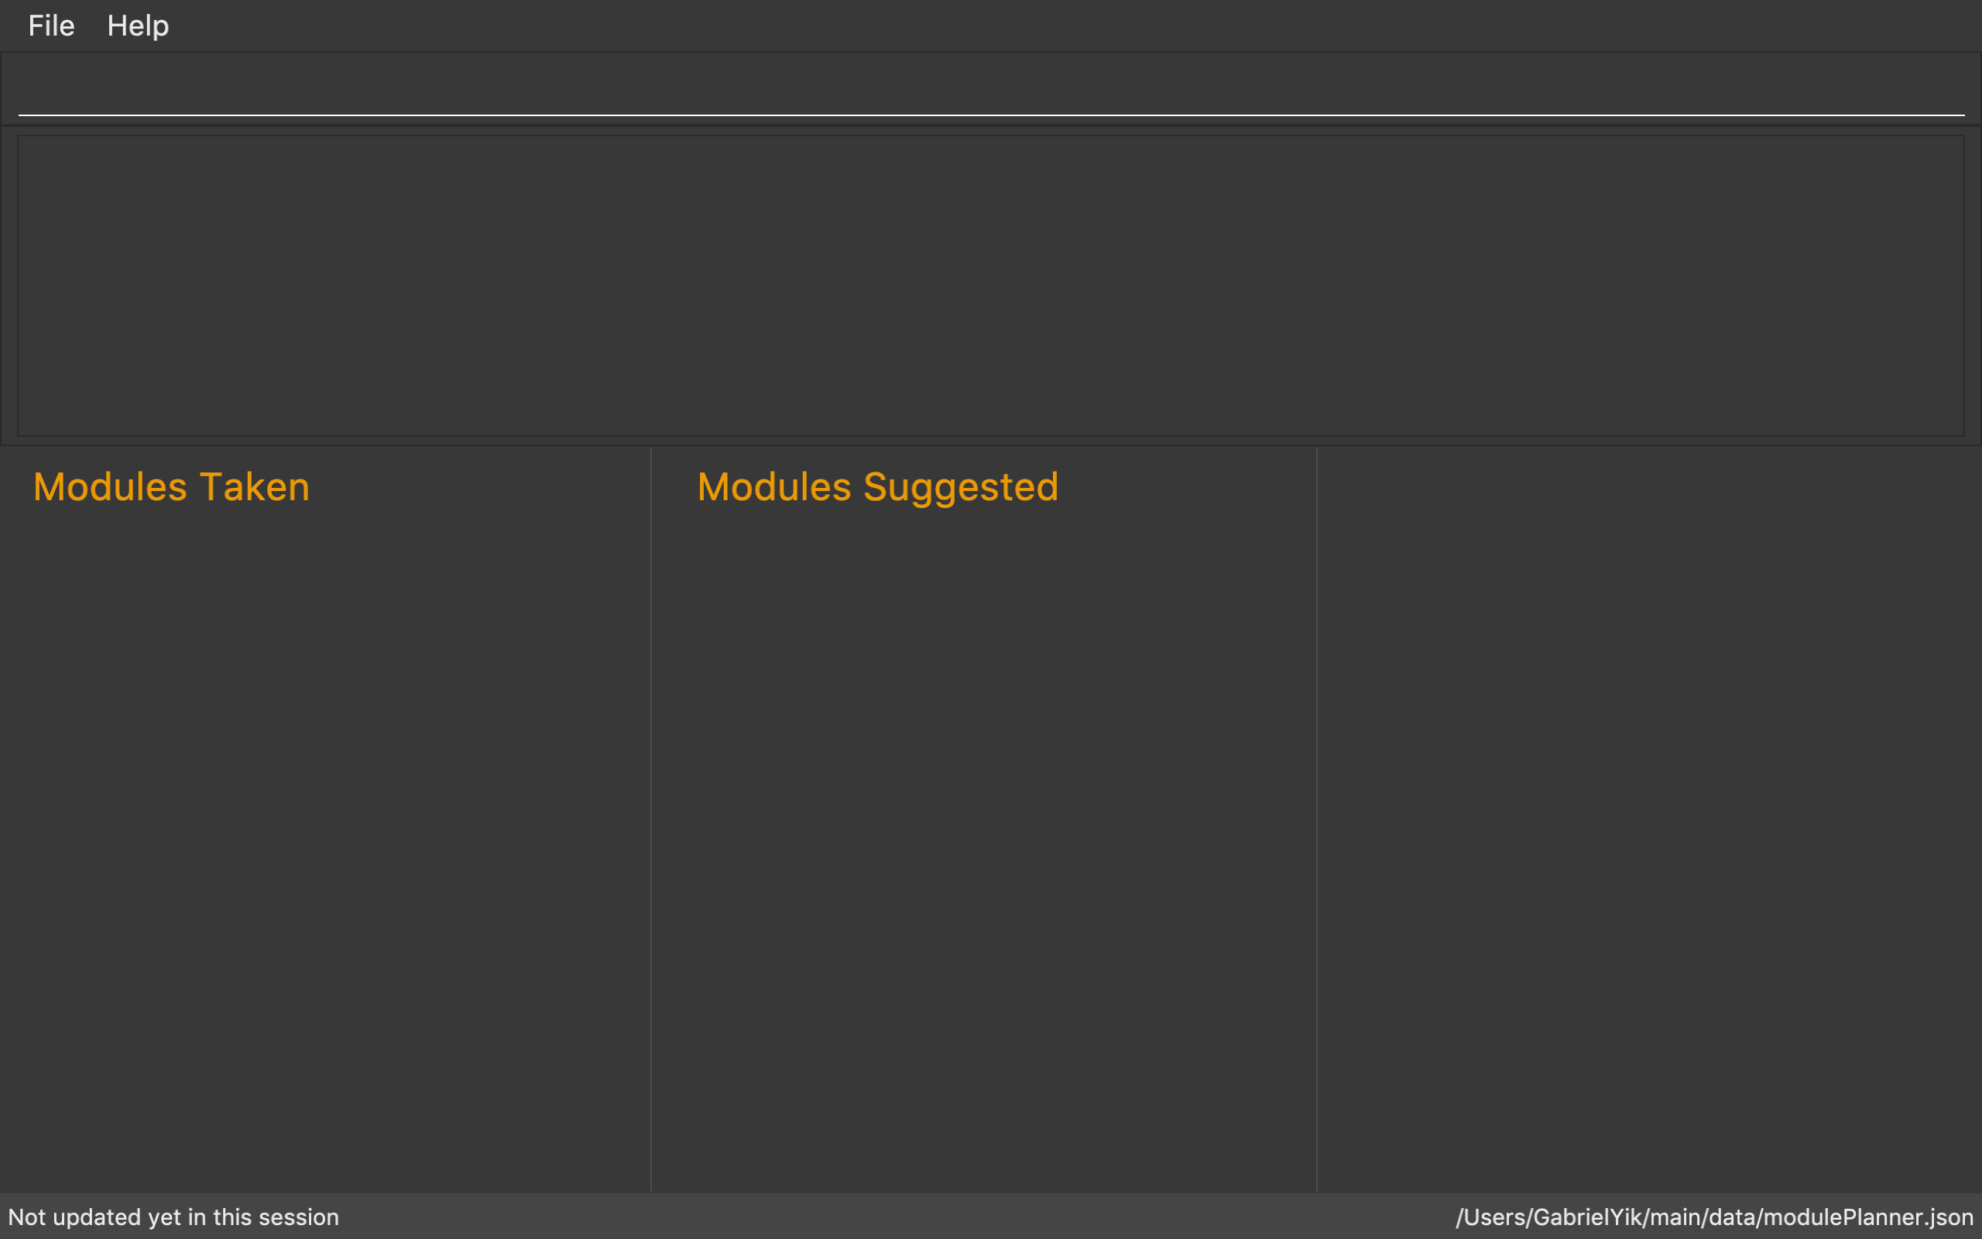
Input Box
Result Display
Modules Taken Panel
Modules Suggested Panel
Multipurpose Panel
Time period
Time period

